Slide 1
Managing Files and Directories
Create and Edit Text Files
Search for Files
Perform Operations on Files and Directories
Process Text Files
Manipulate File Output

Slide 2
Text Editors
An application that enables you to view, create, or modify the contents of text files.
Used to edit a variety of text-based files.
Many types of editors are available in Linux.
Don't always support same formatting options as word processors.
Can work in CLI or GUI.
Have different modes of operation.
Many configuration components in Linux are text files.
You'll configure most of these components using text editors.
Being comfortable with text editors is essential.

Slide 3
Common Editors
vi
Vim
Emacs
gVim
gedit
GNU nano

Slide 4
Vim (Slide 1 of 2)
An extended version of the vi editor.
Implements text-based interface for advanced text editing.
Favored by many sysadmins and developers.
Efficient and highly customizable.
Includes:
Text completion.
Syntax highlighting.
Spell checking.
Many more features.

Slide 5
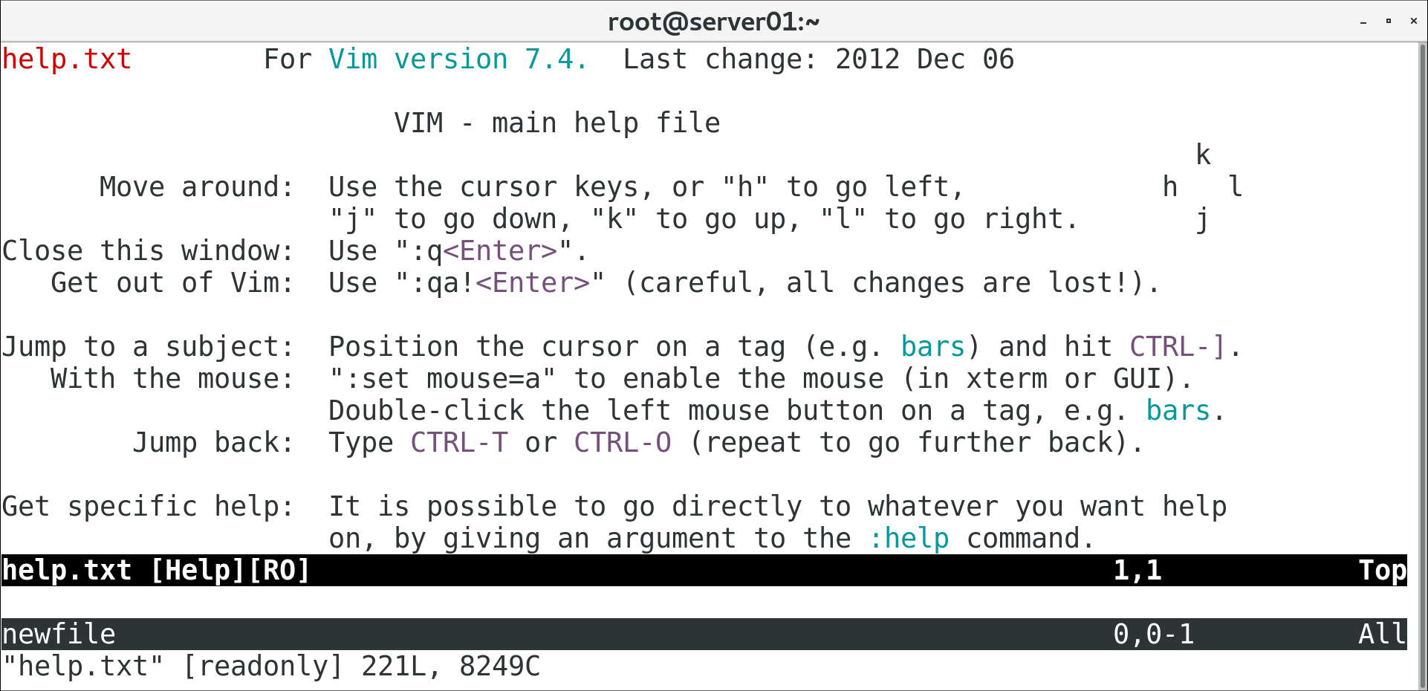
Vim (Slide 2 of 2)

Slide 6
The vim Command
Invokes Vim text editor.
vi redirects to Vim.
Without an argument, command opens welcome screen.
Use vim {file name} syntax to open a file.
If no file exists, Vim creates one with that name and opens it.
Supports multiple files opened simultaneously.

Slide 7
Vim Modes
Mode | Enables Users To
Insert | Insert text by typing.
Execute | Execute commands within the editor.
Command | Perform different editing actions using single keystrokes.
Visual | Highlight or select text for copying, deleting, etc.

Slide 8
Switch Modes (Slide 1 of 2)
Key | Function
i | Switches to insert mode and inserts text to left of cursor.
A | Switches to insert mode and adds text at end of line.
I | Switches to insert mode and inserts text at beginning of line.
o | Switches to insert mode and inserts text on new line below cursor.
O | Switches to insert mode and inserts text on new line above cursor.
v | Switches to visual mode to enable selection, one character at a time.
V | Switches to visual mode to enable selection, one line at a time.
: | Switches to execute mode to enable users to enter commands.
Esc | Returns to command mode.

Slide 9
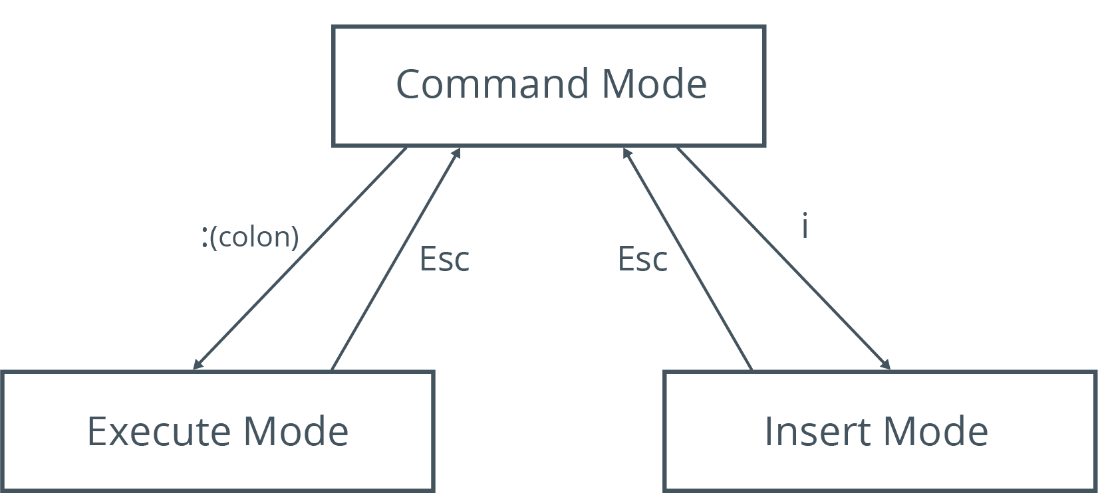
Switch Modes (Slide 2 of 2)

Slide 10
Execute Mode Commands
Command | Function
:w {file name} | Saves file with specified name.
:q | Quits when no changes have been made after last save.
:q! | Quits, ignoring changes made.
:qa | Quits multiple files.
:wq | Saves current file and quits.
:e! | Reverts to last saved format without closing file.
:!{any Linux command} | Executes command and displays results in Vim.
:help | Opens Vim's built-in help documentation.

Slide 11
Motions (Slide 1 of 2)
Single-key shortcuts that are used to navigate through files in command mode.
Navigation Key | Used To
h | Move left one character.
j | Move down one line.
k | Move up one line.
l | Move right one character.
^ | Move to the beginning of the current line.

Slide 12
Motions (Slide 2 of 2)
Navigation Key | Used To
$ | Move to the end of the current line.
w | Move to the next word.
b | Move to the previous word.
e | Move to the end of the current word or to the end of the next word.
Shift+L | Move the cursor to the bottom of the screen.
Shift+H | Move the cursor to the first line of the screen.
(Line #) Shift+G | Move the cursor to the specified line number.
gg | Move the cursor to the first line of the file.
Shift+G | Move the cursor to the last line of the file.

Slide 13
Editing Operators (Slide 1 of 2)
Keystrokes that can quickly manipulate text in a text editor.
Editing Operator | Used To
x | Delete character selected by cursor.
d | Delete text.
dd | Delete current line.
p | Paste text on line below cursor.
P | Paste text on line above cursor.
/{text string} | Search through document for specified text.
?{text string} | Search backward through document for specified text.

Slide 14
Editing Operators (Slide 2 of 2)
Editing Operator | Used To
y | Copy text.
yy | Copy line above cursor.
c{range of lines}c | Begin a change in specified range.
u | Undo latest change.
U | Undo all changes on current line.
ZZ | Write file only if changes were made, then quit Vim.

Slide 15
GNU nano (Slide 1 of 2)
A small, user-friendly text editor that evolved from the Pico text editor created for Unix-like systems.
Vim is powerful, but not user-friendly.
Multiple modes, bare interface, some unintuitive commands, etc.
GNU nano is more visually helpful.
Displays command shortcuts at bottom of screen.
GNU nano has fewer commands, and commands share a common prefix.
GNU nano doesn't have modes.
GNU nano lacks some Vim features and is less powerful.

Slide 16
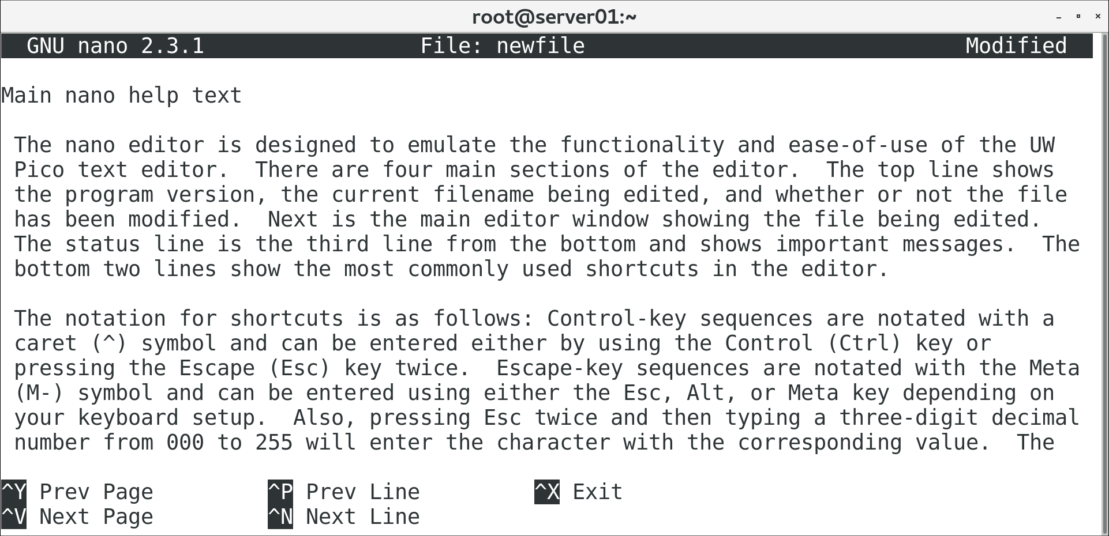
GNU nano (Slide 2 of 2)

Slide 17
The nano Command
Invokes GNU nano text editor.
Without an argument, opens a new file for editing.
You can save and specify name later.
Use nano {file name} syntax to open a file.
If no file exists, nano creates one with that name and opens it.
Supports opening multiple files simultaneously.
Files opened in different "buffers" you can switch between.

Slide 18
nano Shortcuts
Shortcut | Used To
Ctrl+G | Open nano to help screen.
Ctrl+X | Exit nano or close current buffer.
Ctrl+O | Save currently open file.
Ctrl+J | Justify current paragraph.
Ctrl+R | Insert another file into the current one.
Ctrl+W | Search the file.
Ctrl+K | Cut the currently selected line.
Ctrl+U | Paste the line that was cut.
Ctrl+C | Display the cursor's position.

Slide 19
The gedit Text Editor (Slide 1 of 2)
The default GUI text editor used in GNOME desktop environments.
Unlike Vim and nano, gedit has a menu-based design.
Easy to work with.
Features syntax highlighting, spell checking, customization, etc.
Not as powerful as Vim, but still useful if desktop is installed.
Can be launched from desktop or through gedit command.
Similar syntax to vim and nano commands.

Slide 20
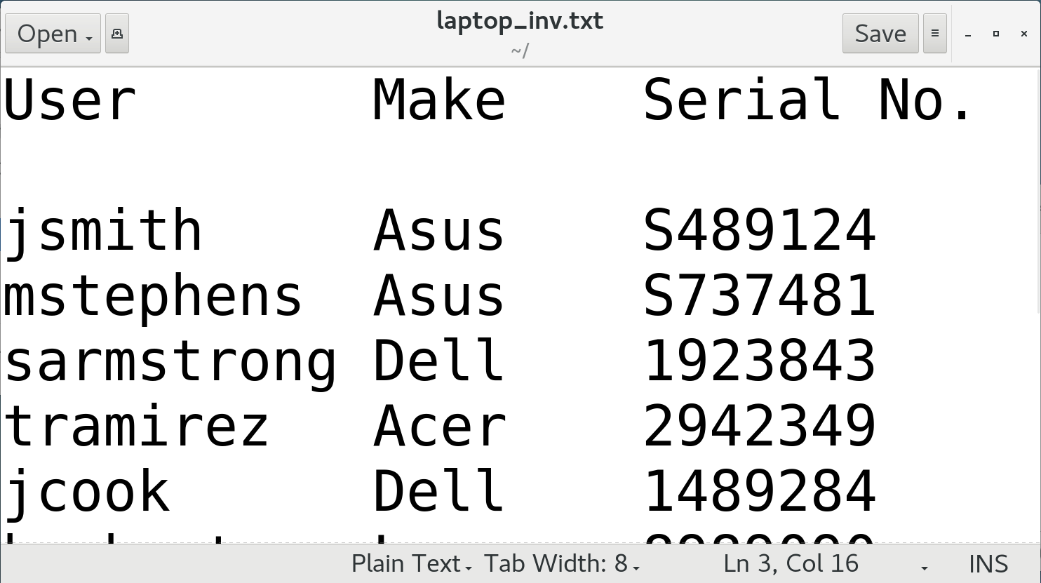
The gedit Text Editor (Slide 2 of 2)

Slide 21
Discussing Creating and Editing Text Files

Slide 22
Activity: Creating Text Files
You've been asked to start a list of required software.
You'll create a text file and begin entering names.
You'll save your work and pick up with it later.

Slide 23
Activity: Editing Text Files
A colleague has filled out the software list.
You want to check it for errors and correct any.
You'll edit in both Vim and GNU nano to get a feel for them.

Slide 24
The locate Command (Slide 1 of 2)
Performs a quick search for specified string in file names/paths.
File names/paths are stored in mlocate database.
Must be updated regularly for search to be effective.
Results may be restricted based on access permissions.

Slide 25
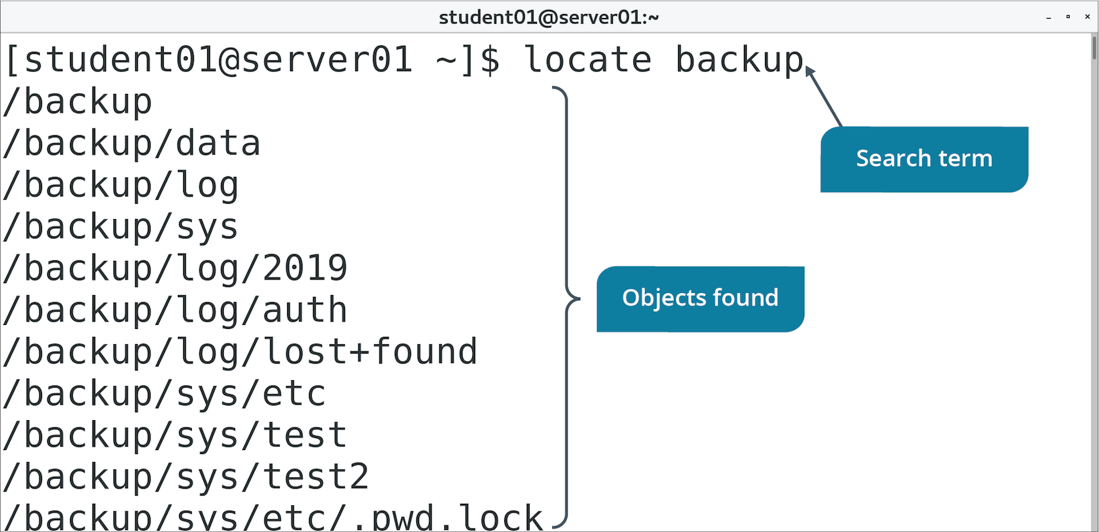
The locate Command (Slide 2 of 2)

Slide 26
The find Command
Search specific locations for files and directories using search criteria.
Recursively searches directory structure.
You can perform one or more actions on files found.
Use -type to specify object type you're looking for.
Use -name to specify name of object you're looking for.

Slide 27
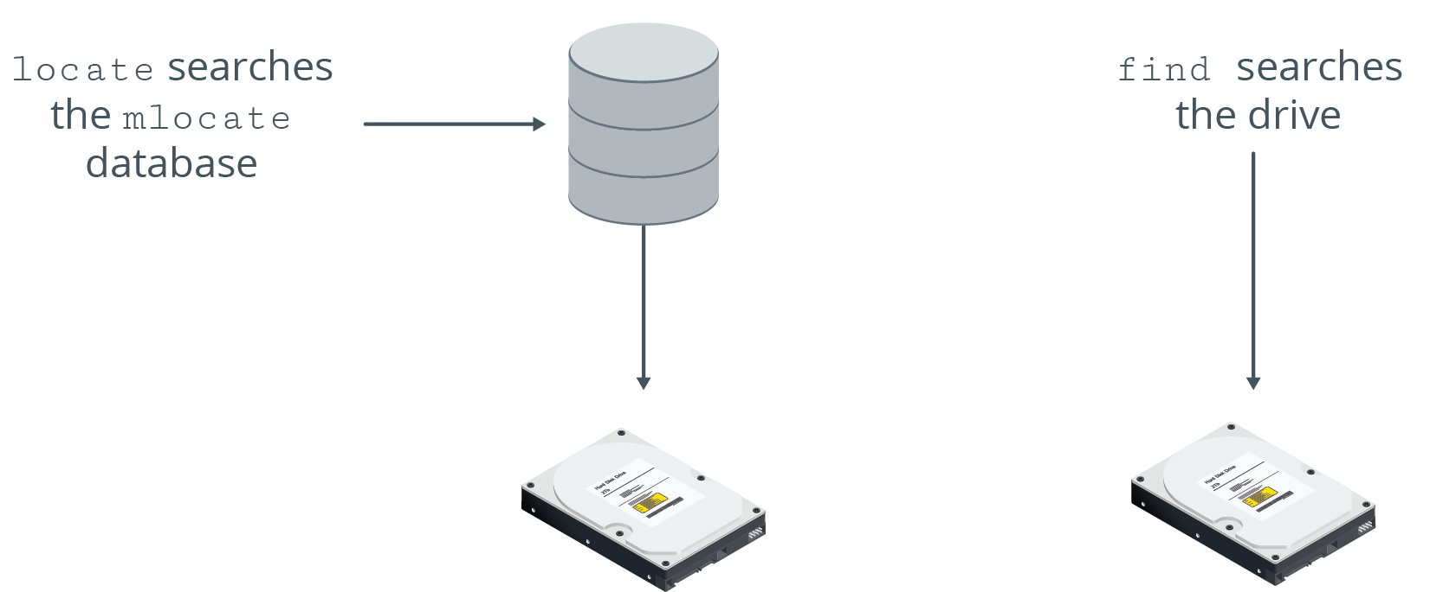
find vs. locate Commands

Slide 28
The which Command (Slide 1 of 2)
Displays complete path of specified command.
Searches directories assigned to PATH variable.
Example: which cat outputs /bin/cat
Useful if you need to locate where a program has been installed.
Useful for identifying which version of a command is running.
Command might have different binaries in different locations.

Slide 29
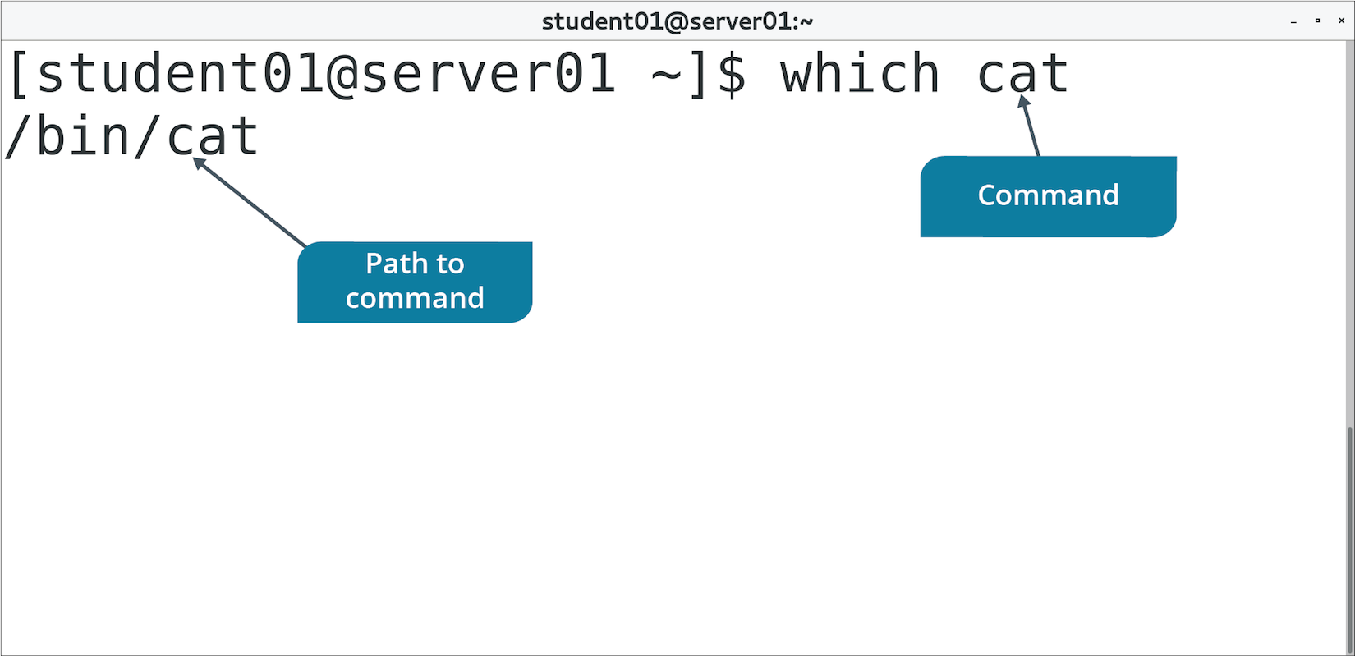
The which Command (Slide 2 of 2)

Slide 30
The whereis Command (Slide 1 of 2)
Displays various details associated with a command.
Example: whereis ls
Output: ls: /bin/ls /usr/share/man/man1/ls.1.gz /usr/share/man/man1p/ls.1p.gz
/bin/ls indicates location of ls command.
The rest indicates location of ls man pages.

Slide 31
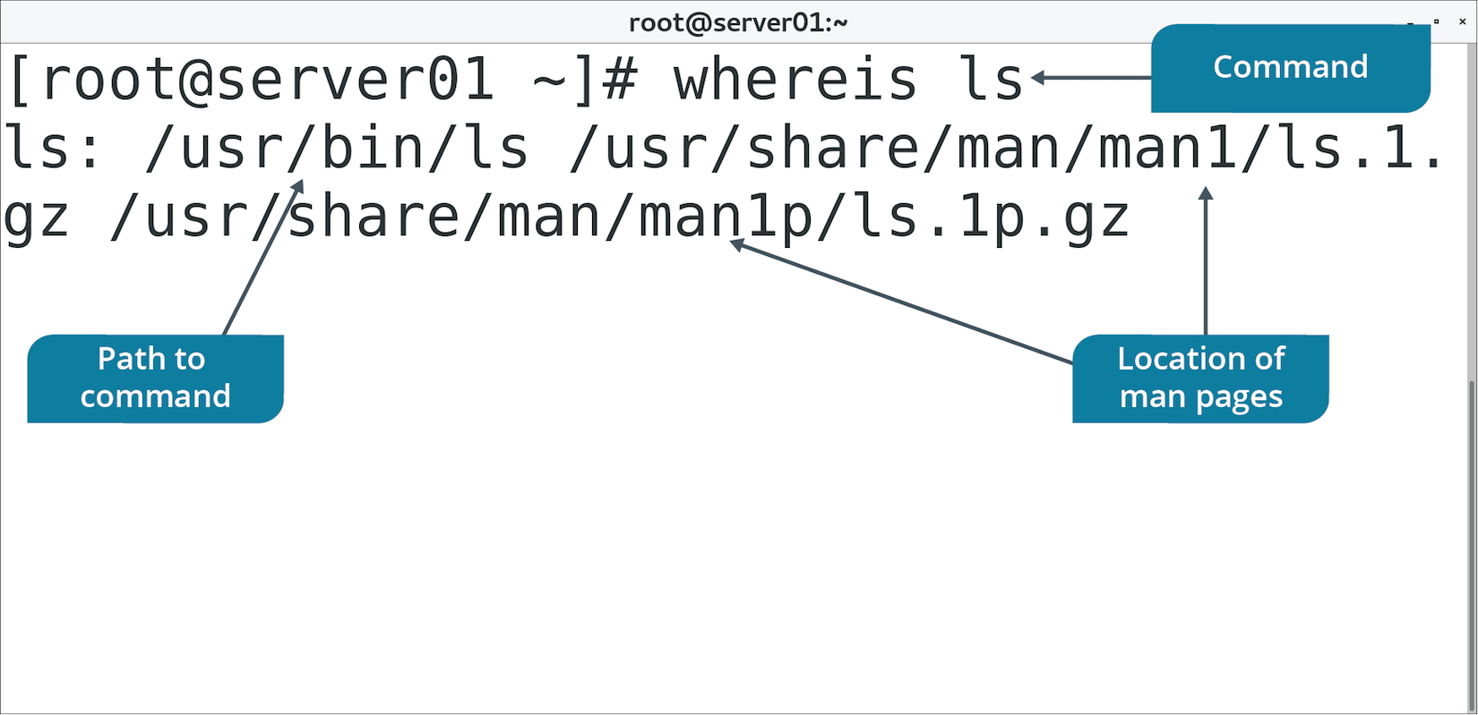
The whereis Command (Slide 2 of 2)

Slide 32
Discussing Searching for Files

Slide 33
Activity: Searching for Files
You need to ensure logs are functioning as expected.
Crucial to diagnosing problems.
You'll start by searching for where logs are stored.
Then you'll search for logs meeting requirements:
Above a certain size.
Updated recently.

Slide 34
The cat Command
Displays, combines, and creates text files.
Usually used to display contents of small text files.
Option | Used To
-n | Precede output with respective line number.
-b | Number lines, excluding blank lines.
-s | Suppress output of repeated empty lines.
-v | Display non-printing characters as visible characters.
-e | Print $ at the end of each line.
-t | Print tabs as ^I and form feeds as ^L

Slide 35
The head and tail Commands (Slide 1 of 2)
head displays first 10 lines of a file.
tail displays last 10 lines of a file.
Useful when you only need to see beginning or end of a file.
Example: Check only 10 most recent log entries using tail

Slide 36
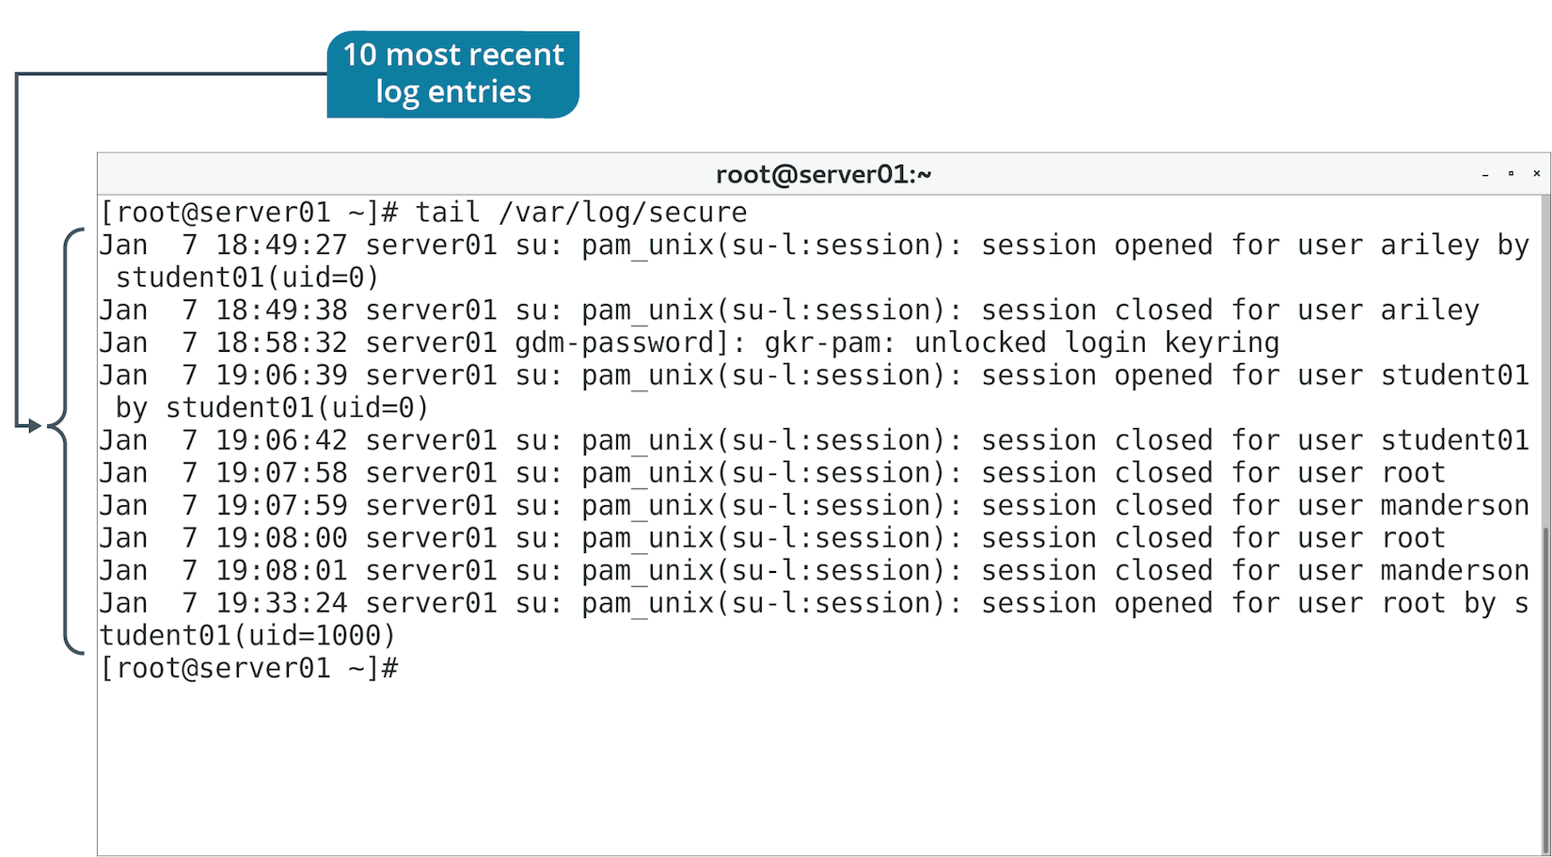
The head and tail Commands (Slide 2 of 2)

Slide 37
The less and more Commands (Slide 1 of 2)
Both are used to page through lengthy text files.
less has additional features; newer versions of more added some as well.
less is preferred.

Slide 38
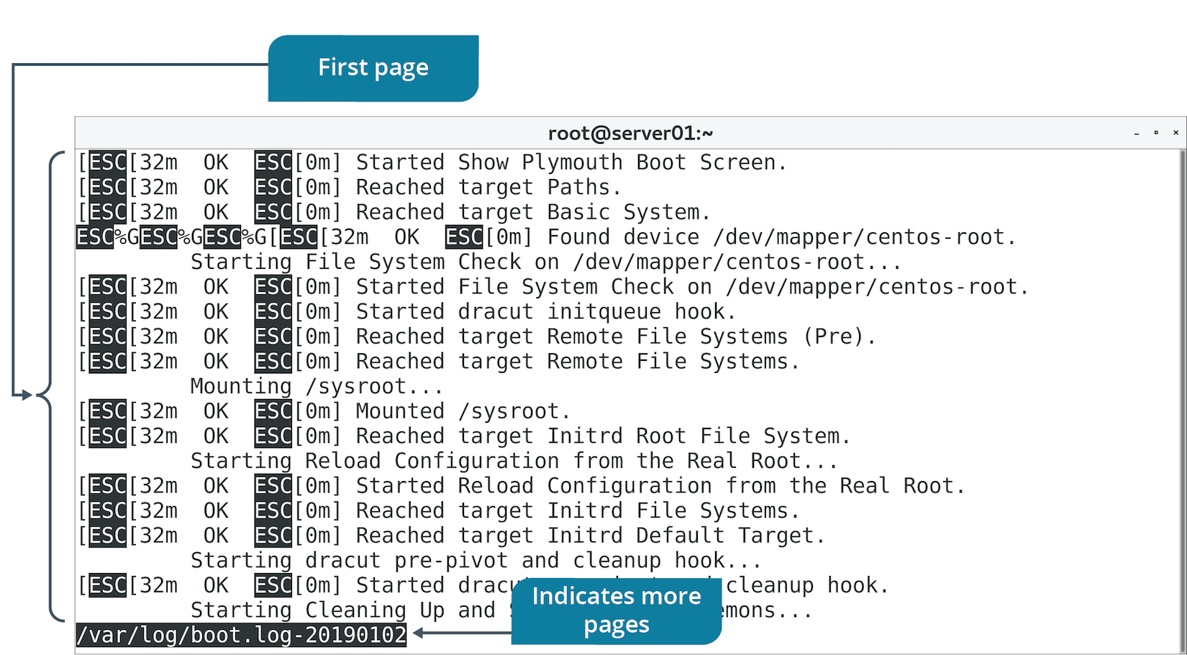
The less and more Commands (Slide 2 of 2)

Slide 39
The cp Command
Enables you to copy and then paste files or directories.
Initial object is left where it is.
Duplicate object is created in location you specify.
Must use -R option to copy directories recursively.

Slide 40
The mv Command
Moves files/directories.
Similar to cp, but doesn’t leave initial object intact.
More like a cut and paste operation.
Also used to rename files/directories.
No dedicated rename command in Bash.
"Moving" object to new name destination essentially renames it.

Slide 41
The touch Command
Changes time of access/modification time of file.
Changes to current time or with time provided in argument.
Also used to create blank files.
File name is supplied in argument.
Useful for testing purposes.

Slide 42
The rm Command
Removes files/directories.
Must use -R option to recursively remove:
Files
Subdirectories
Parent directory

Slide 43
The ls Command
Lists contents of directories, permissions of files/directories, and more.
Option | Used To
-l | Display long list including permissions, owner, group, size, etc.
-F | Display nature of file (executable, directory, etc.).
-a | Display all files, including "hidden" files.
-R | Recursively display all subdirectories.
-d | Display info about symbolic links.
-L | Display all files including symbolic links.

Slide 44
The mkdir and rmdir Commands
mkdir creates directories.
You supply name of directory as argument.
rmdir removes blank directories only.
Must use rm -R to delete directories with contents.

Slide 45
Discussing Performing Operations on Files and Directories

Slide 46
Activity: Reading Files
One of your duties is to review logs.
Before diving into analysis, you'll need to select the best reader to use.
You'll use commands like cat and less to see which is most applicable and when.

Slide 47
Activity: Manipulating Files and Directories
You need to move policy documents from HR workstation to a server.
More centrally located.
HR lead didn't do a good job organizing files.
Old policies mixed in with current ones.
Inconsistent naming.
All in aups folder.
You'll copy files to your home directory temporarily.
You'll keep active policies and delete old ones.
You'll rename aups to policies to be more general.
You'll add some placeholders for future policy files.

Slide 48
The echo Command (Slide 1 of 2)
Used to display line of text at the terminal.
Can also be used to write text to a file.
Uses redirection.

Slide 49
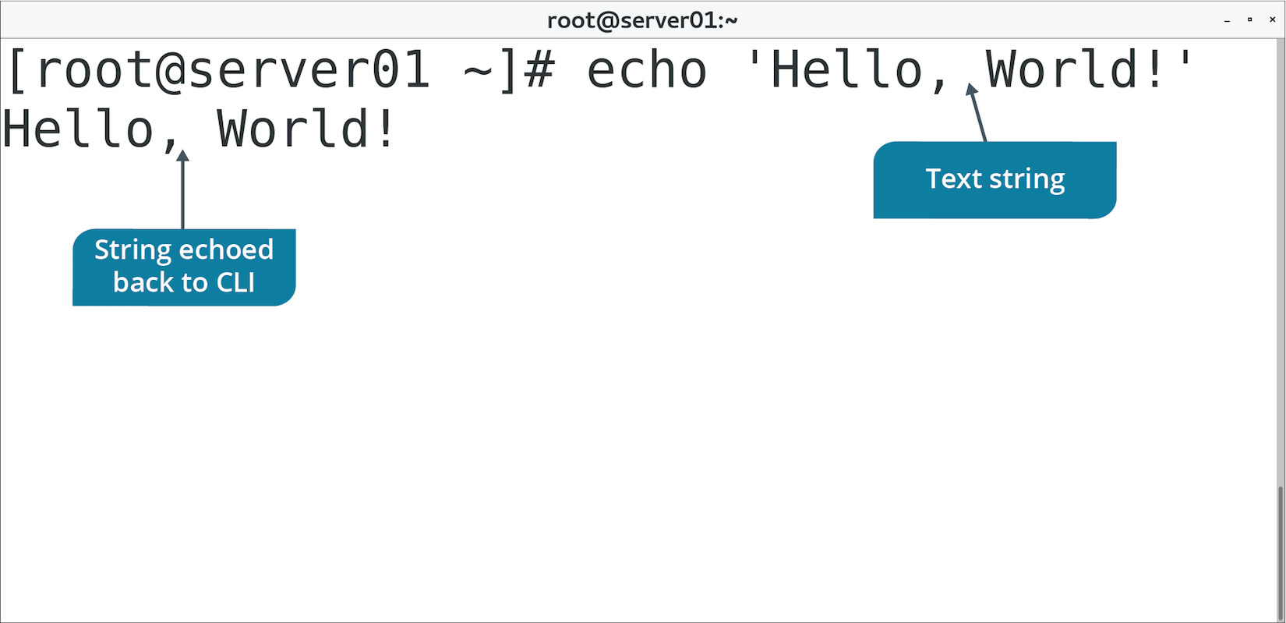
The echo Command (Slide 2 of 2)

Slide 50
The tr Command
Used to translate string of characters.
Usually used to change cases of letters.
Acts only on stream; can't change file contents directly.
Requires redirection.

Slide 51
The wc Command (Slide 1 of 2)
Used to count number of lines, words, and characters in a file.
With multiple files, wc displays counts for each file and total for all files.

Slide 52
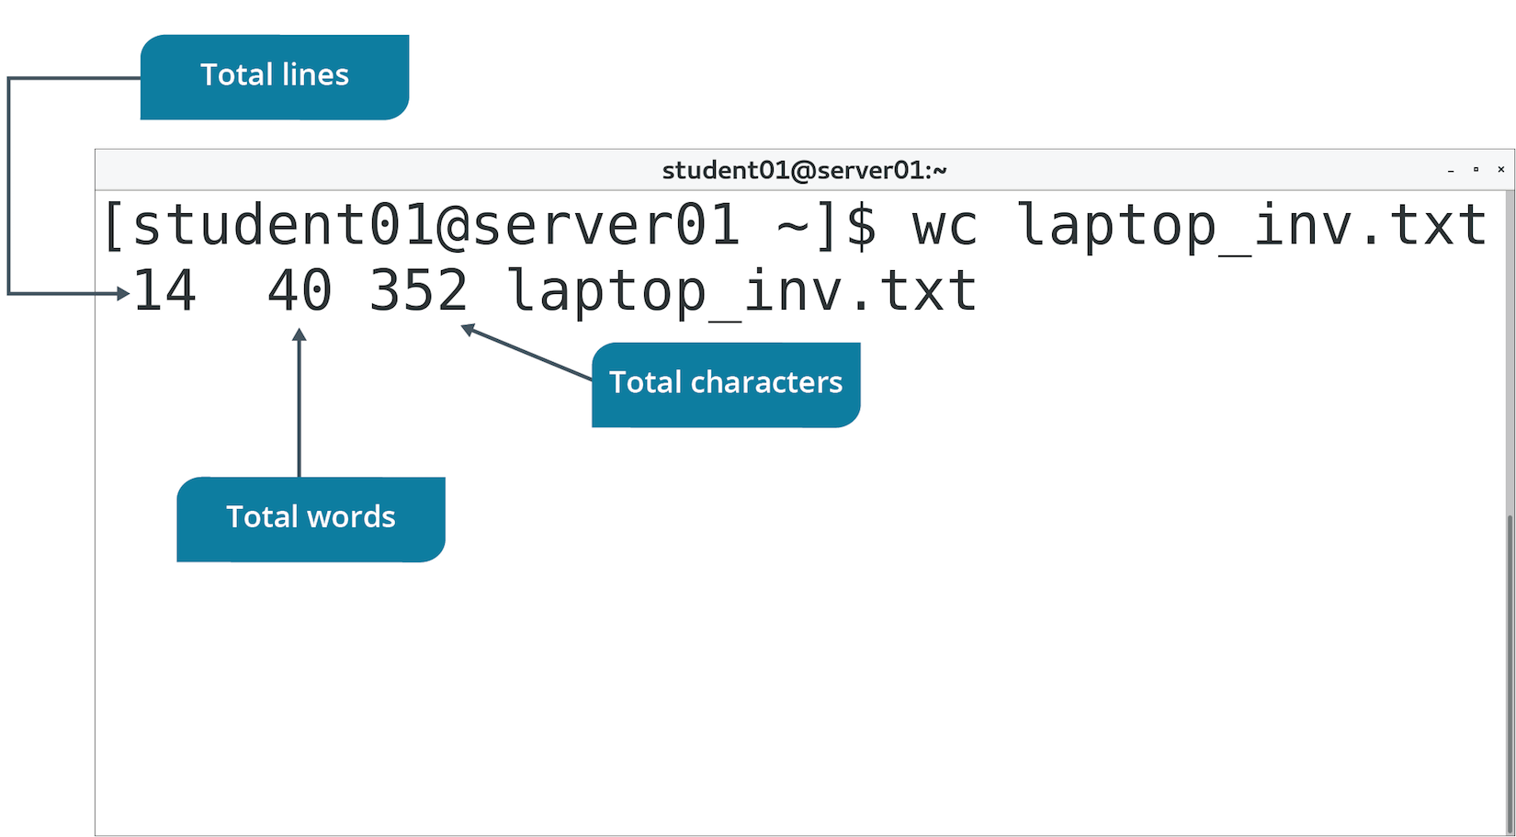
The wc Command (Slide 2 of 2)

Slide 53
The sort Command (Slide 1 of 2)
Arranges the lines in a file.
Option | Used To
-k{column numbers} | Specify field values.
-n | Compare and sort lines based on string numerical value.
-r | Sort fields in descending order.
-t{delimiter} | Separate one field from another.

Slide 54
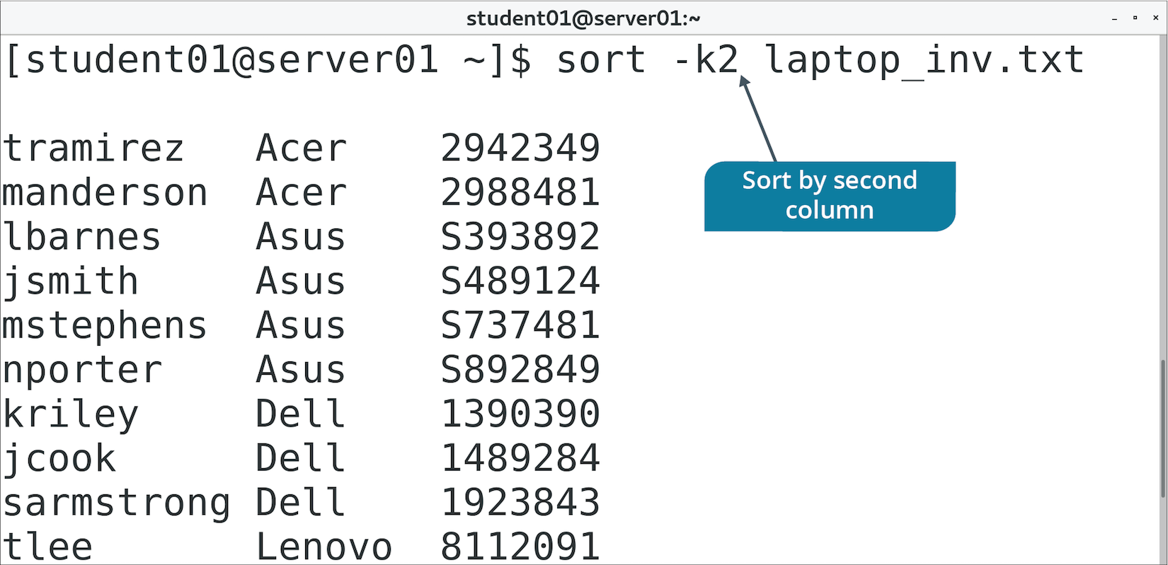
The sort Command (Slide 2 of 2)

Slide 55
The cut Command (Slide 1 of 2)
Extracts specified lines of text from a file.
Option | Used To
-c | Specify the number of the character to cut from each line.
-d{delimiter} | Separate one field from another.
-f{field numbers} | Specify field numbers to cut on as separated by delimiter.
-s | Suppress line if delimiter is not found.

Slide 56
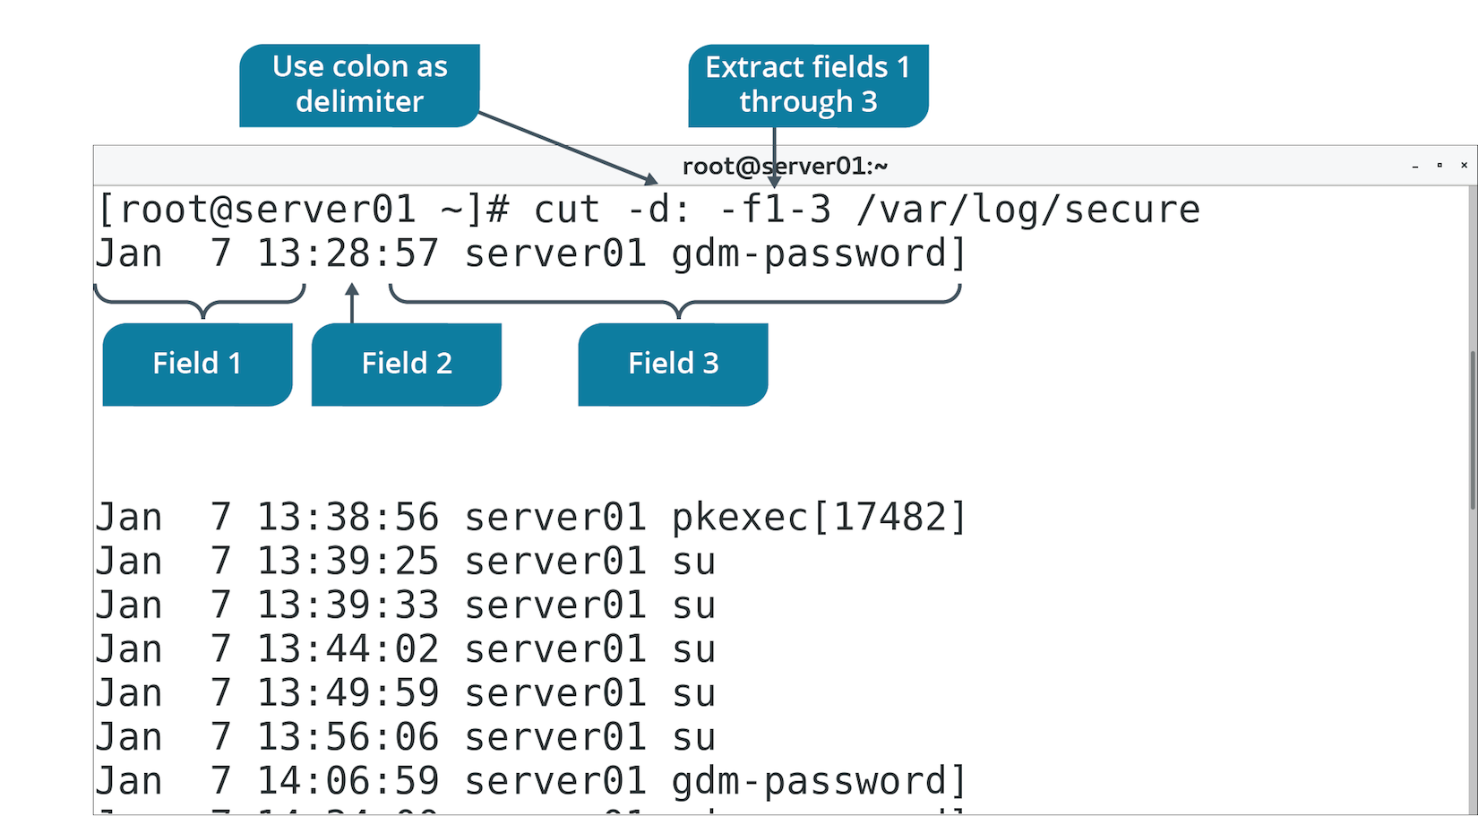
The cut Command (Slide 2 of 2)

Slide 57
The paste Command (Slide 1 of 2)
Used to merge lines from text files horizontally.
Each line of first file is a row in first column.
Each line of second file is a row in second column.
Default delimiter is a tab space; use -d option to specify another.
cities file:
New York
Tokyo
London
Lima
countries file:
United States
Japan
England
Peru

Slide 58
The paste Command (Slide 2 of 2)
Output of paste -d , cities countries
New York,United States
Tokyo,Japan
London,England
Lima,Peru

Slide 59
The diff Command (Slide 1 of 2)
Compares text files.
Displays two files and differences between them
Uses symbols to suggest how to change one file to make it identical to the other.
Each symbol has a special meaning.
< {line} means line should be removed from first file.
> {line} means line should be added from second file.
Also denotes line numbers for each file affected by deletion, addition, and changes.

Slide 60
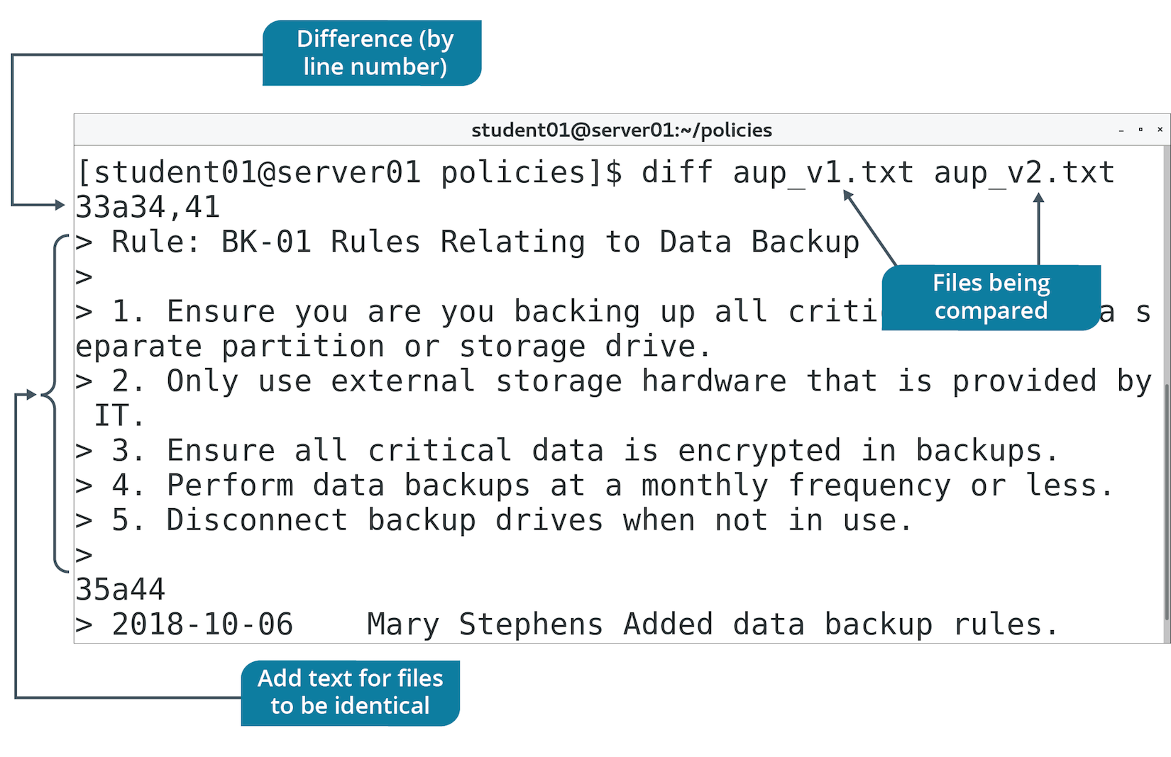
The diff Command (Slide 2 of 2)

Slide 61
The grep Command (Slide 1 of 2)
A search tool.
Not limited to finding file names.
Often used to search contents of files.
Output displays each line of file that matches your provided search pattern.
You can process and read contents pertinent to you.
Example: Retrieve login events of specific user.
Don't need to read entire file.
Don't need to step through a search in a text editor.
Use grep to print all the relevant lines.

Slide 62
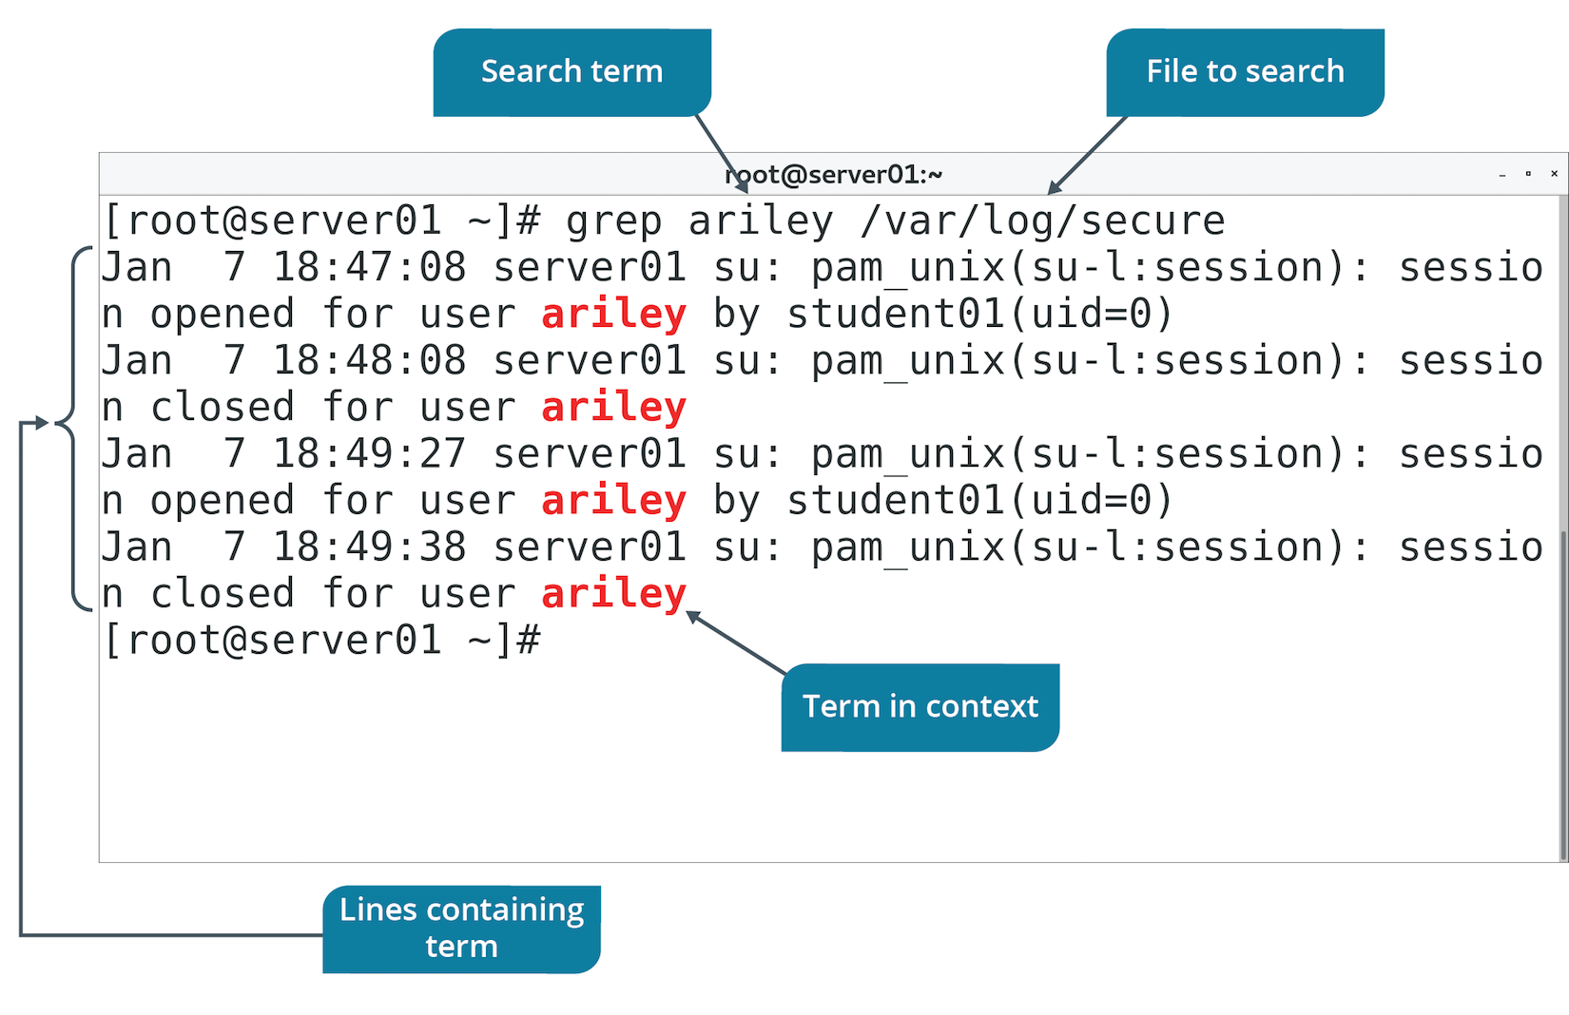
The grep Command (Slide 2 of 2)

Slide 63
The awk Command (Slide 1 of 2)
Performs pattern matching on files.
Based on AWK programming language.
Keyword is followed by pattern, action to perform, and file name.
Action is placed in curly braces.
Pattern and action should be inside single quotes.
Can be used from command line or execute as a script.
Can process files in a variety of ways:
Retrieve text matching pattern.
Delete text matching pattern.
Add text matching pattern.
Much more.

Slide 64
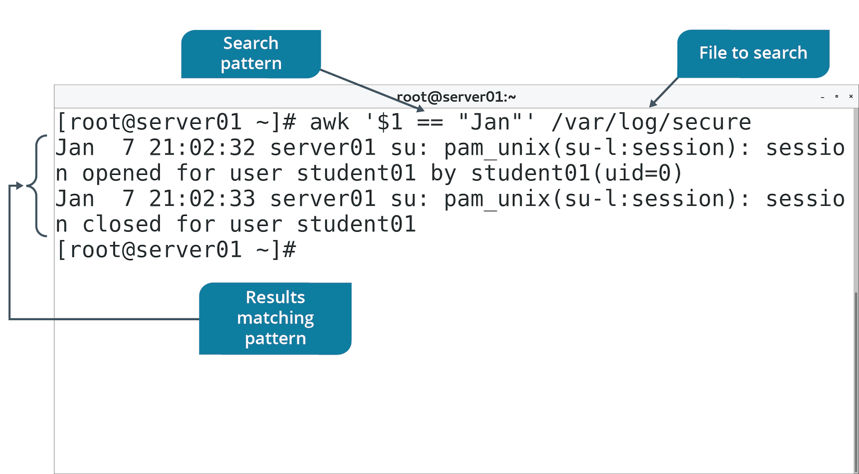
The awk Command (Slide 2 of 2)

Slide 65
The sed Command (Slide 1 of 3)
Stream editor used to modify text files according to various parameters.
Can also be used for global search and replace actions.

Slide 66
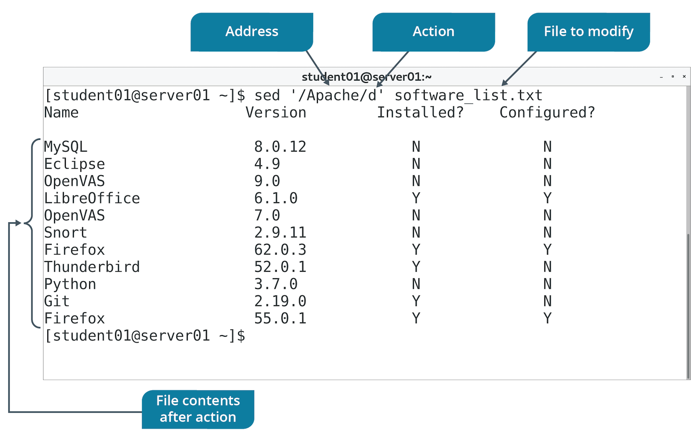
The sed Command (Slide 2 of 3)

Slide 67
The sed Command (Slide 2 of 3)
Option | Used To
d | Delete lines matching a pattern.
-n,p | Print only lines containing pattern.
s | Substitute first occurrence of string in file.
s,g | Globally substitute original string with replacement string for each occurrence.

Slide 68
The ln Command
Used to create a link to a file.
File name in one directory (link) points to file in another directory (target).
Link doesn't contain data, only reference to target.
Changes to link reflect in the target.
If you don't specify link name, it will be created in current working directory.

Slide 69
Types of Links
You can use ln to create hard or symbolic links.
Feature of file systems like ext2,3,4 and XFS.
Hard links:
Apply to files only, not directories.
File data has more than one location on file system.
If main file is deleted, data will be still available in link.
Cannot be created between files on different file systems.
Symbolic links:
Can be created between two file systems.
If main file/directory is deleted, content is lost.
Also known as soft links.

Slide 70
Discussing Processing Text Files

Slide 71
Activity: Processing Text Files
You want to begin analyzing documents.
Sort the software list to see what needs to be installed/configured.
What has changed from v1 to v2 of AUP.
Also need to perform some log analysis.
Identify failed logins.
Users may try to access resources they shouldn't.
Extract only relevant info from the log.

Slide 72
Activity: Linking Files
You want to organize your backup directory.
Create subdirectories, each one a category of log.
By type.
By year.
Logs will cross multiple categories.
Create links instead of copies.
Easier to manage.
Also create a link from your home directory to logs in backup.
For easy access.

Slide 73
Text Streams
A sequence of lines of text that applications can leverage to read from or write to a particular device or system component.
Enables app to interface with components like:
CLI
Files
Network sockets
Hides components' details from the app.
Linux text stream types:
Standard input
Standard output
Standard error

Slide 74

Standard Input
A text stream that acts as the source for command input.
Also called stdin.
Standard input for command-line usually comes from keyboard.
In GUI, stdin can also come from mouse.
Input

Slide 75

Standard Output
A text stream that acts as the destination for command output.
Also called stdout.
Directed to CLI by default.
Output

Slide 76
Standard Error
A text stream that is used as the destination for error messages.
Also called stderr.
Prints error messages to CLI by default.
Error Messages

Slide 77
Input/Output Redirection
The process of accepting input from a source other than the keyboard and sending output to a destination other than the display device.
Can bypass default devices when working with I/O.
Typically used to read input from files and send output to files.
Uses stdin, stdout, and stderr streams.

Slide 78
Redirection Operators
Operator | Used To
> | Redirect stdout to a file.
>> | Append stdout to the end of a file.
2> | Redirect stderr to a file.
2>> | Append stderr to the end of a file.
&> | Redirect both stdout and stderr to a file.
< | Read input from file rather than keyboard/mouse.
<<string | Provide input data from current source, stopping at a line containing provided string. Called a here document.

Slide 79
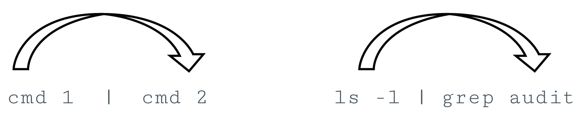
Piping
The process of combining the standard I/O streams of commands.
Standard output of one command is used as standard input for another.
Output format of first command should be compatible with second.
Pipe operator (|) can be used with most Linux commands.

Slide 80
The xargs Command (Slide 1 of 2)
Reads from stdin and executes command for each argument provided.
Argument must be separated by blanks.
Pipe makes output of first command the input for second command.
Commonly used with find command.
Operate on each result of a file/directory search.

Slide 81
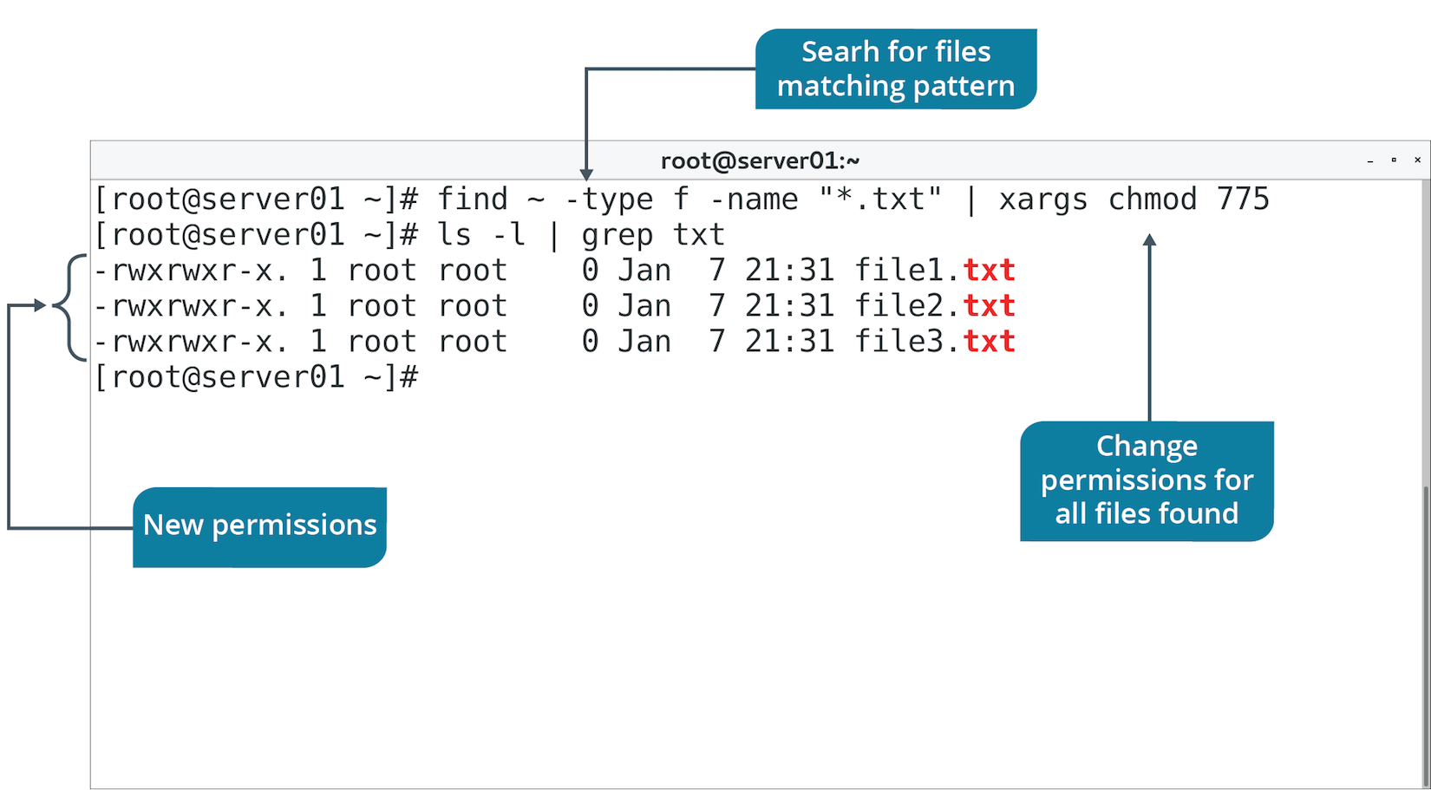
The xargs Command (Slide 2 of 2)

Slide 82
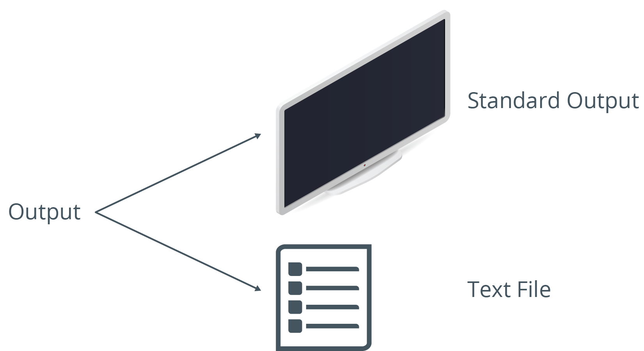
The tee Command
Reads stdin, sends output to CLI, and copies output to specified files.
You can verify command output now and store it in a file for later.
Accepts input from another command using a pipe.
The -a option appends to file instead of overwriting.

Slide 83
The /dev/null File
A file that discards all data written to it.
Also called the null device.
You can redirect output to this file to:
Confirm output was successful.
Not actually write data.
Useful in testing commands, scripts, etc.
Also useful in suppressing error info in commands.
Redirect error output (2>) to /dev/null file.

Slide 84
Terminal Redirection
A running process can be controlled by a terminal.
Multiple terminals can run at once.
Each terminal is assigned an identifier.
Usual format is /dev/tty#
You can redirect stdin and stdout to controlling terminals.
Reference its /dev/tty number.
Useful for redirecting text streams between processes.

Slide 85
Discussing File Output

Slide 86
Activity: Manipulating File Output
IT keeps an inventory of issued laptops.
You need to move info to a Linux server.
Source isn't formatted very well.
You'll create a new file, fix its mistakes, and then sort it.
You also want to check the backup directory.
Use tee to see results at CLI and output to a file.
You'll also use piping with grep to hone your log analysis skills.

Slide 87
What are some ways that leveraging the power of text streams and standard I/O could enhance your administrative tasks on Linux systems?
Which Linux text editor do you prefer to use? Why?

